Slide 1
Balancing Equations Lab
By Mrs. Sara Al Hamarneh

Slide 2
Instructions ( In class students)
Pair up (one student can submit their work/ include the name of your partner)
Write each equation on a piece of paper, balance it, then represent the balanced reaction with pompoms. Use the pompoms to represent atoms.
Set up the reactants and products using the correct number of pompoms in each molecule and fill in the coefficients if needed.
Take a picture of your work using your pompoms equation and submit it for each equation.

Slide 3
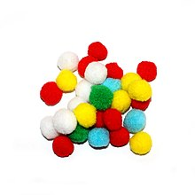
Data Table
This Photo by Unknown Author is licensed under CC BY-SA
Atom | O | H | Na | Cl | K | Ca
Color: | White | Pink | Orange | Green | Purple | Blue
Number | 12 | 8 | 4 | 4 | 4 | 2

Slide 4
Instructions for online students
You will need to come up and gather different materials. You will use these different materials to represent the different kinds of atoms in the first two equations. (keep in mind, using the same material for the same kind of atom in both the reactants and products).
An example of some materials you can use are cheerios/ beads/ different kind of beans/ cereal/ pompoms/ or any other material of your choice! Be creative.
You need to balance all equations (type each one), but you only need to represent the first and second equation using your chosen materials. (Set up the molecules and fill in the coefficients if they are needed.)
- Take a picture of your work for each equation and submit it.

Slide 5
Equation 1
How many H pompoms are on the left side? __________ , On the right side? ___________
How many O pompoms are on the left side? __________, On the right side? ____________
Is the equation currently balanced? Yes or No
Write the balanced chemical equation:

Slide 6
Equation 2
Write the balanced chemical equation:

Slide 7
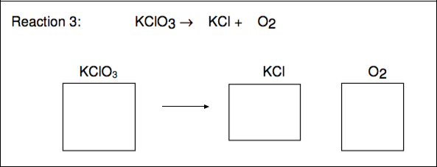
Equation 3
Write the balanced chemical equation:

Slide 8
Balance the following equations
___ H₂ + ___ Br₂ ___ HBr
___ C + ___H₂ ___ CH₄
___ C + ___ O₂ ___ CO
___ H₂O₂ ___ H₂O + ___ O₂

Slide 9
Analysis questions after the lab
What do the pompoms represent in this lab?
What is a coefficient and what does it apply to?

Slide 10
Analysis questions after the lab
How does the Law of conservation of matter apply to the chemical reactions you just did?
Group Names (in class students only):

